Slide 1
Basic Internship@Clevered visual sentiment analyser
App User Manual
Author: Anna-Maria Fahed

Slide 2
Table of Contents
Acknowledgement
About Me
About my internship with clevered
About the app
How do I use the app

Slide 3
Acknowledgements
Thank you to . Mr Ken, Clevered and to Ms Mani who contributed to the development of this app. Your efforts have been invaluable, and I appreciate the collaboration that made it possible.

Slide 4
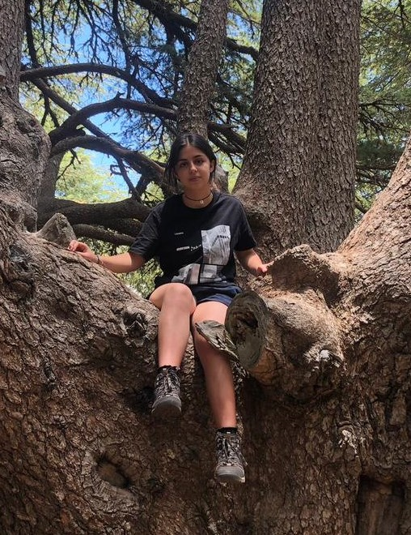
About Me..
Student’s Photograph
Student’s Introduction
Hello, everyone! Im Anna-Maria, a 15 –year-old in 10th grade.

Slide 5
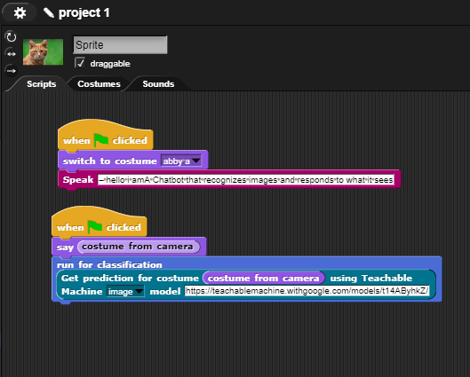
About My Internship with Clevered..
Any photographs from sessions etc.
Your internship experience with Clevered: I had a very interesting experience, concerning the program, I got to know new information about several topics.

Slide 6
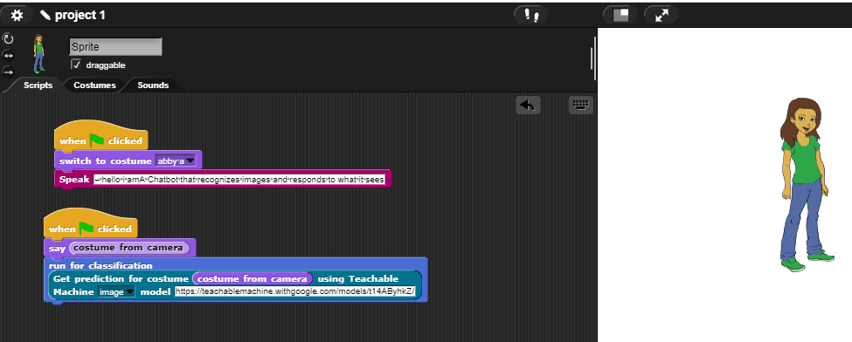
About App..
App’s Main Menu
App’s Introduction
A Chatbot that recognizes images and responds to what it sees

Slide 7
How do I use the App?
When the green flag is clicked the chatbot will present itself. Then we have to show it a picture of a puppy, kitten, wolf, or lion. Then depending of the picture or it will say ‘how cute’ or ‘how scary’

Slide 8
Option Name
(This will be repeated for each option of the App)
Screenshot/ Pic of each option/screen of the App
For my project you need a proper camera
Steps to use the same
Any special considerations/ dependencies/risks while using the option

Slide 9
Contact Person
Please reach out to student name at student’s email address for any questions/ concerns/ suggestions on the App
Name: Anna Maria Fahed
Email address: annamariafahed8@gmail.com

Slide 10
Thank you!

